Slide 1
DATABASE MANAGEMENT SYSTEMS
Subject Teacher: Junaid Javed Korai

Slide 2
WRITING BASIC SQL SELECT STATEMENTS
Lecture # 10
Disclaimer: The material used in this presentation to deliver the lecture i.e., definitions/text and pictures/graphs etc. does not solely belong to the author/presenter. The presenter has gathered this lecture material from various sources on web/textbooks. Following sources are especially acknowledged:
Connolly, Thomas M., and Carolyn E. Begg. Database systems: a practical approach to design, implementation, and management. Pearson Education, 2005.
Gorman,Tim, Inger Jorgensen, Melanie Caffrey, and Lex deHaan. Beginning Oracle SQL: For Oracle Database 12c.Apress, 2014.
Greenberg, Nancy, and Instructor Guide PriyaNathan. "Introduction to Oracle9i: SQL." ORACLE, USA (2001).
2

Slide 3
OBJECTIVES
After completing this lesson, you should be able to do the following:
List the capabilities of SQL SELECT statements
Execute a basic SELECT statement
Differentiate between SQL statements and iSQL*Plus commands

Slide 4
WRITING SQL STATEMENTS
SQL statements are not case sensitive.
SQL statements can be on one or more lines.
Keywords cannot be abbreviated or split across lines.
Clauses are usually placed on separate lines.
Indents are used to enhance readability.

Slide 5
CAPABILITIES OF SQL SELECT STATEMENTS
Projection Selection
Table 1
Table 1
Join
Table 1
Table 2

Slide 6
SELECT FROM
BASIC SELECT STATEMENT
*|{[DISTINCT] column|expression [alias],...}
table;
SELECT identifies what columns
FROM identifies which table

Slide 7
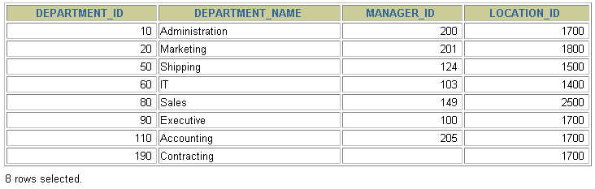
SELECTING ALL COLUMNS
SELECT FROM
*
departments;

Slide 8
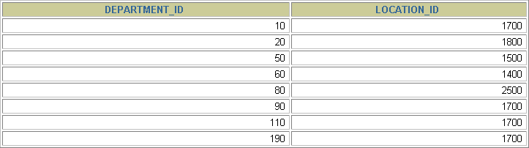
SELECTING SPECIFIC COLUMNS
SELECT FROM
department_id, location_id
departments;

Slide 9
COLUMN HEADING DEFAULTS
iSQL*Plus:
  Default heading justification: Center
  Default heading display: Uppercase
SQL*Plus:
  Character and Date column headings are left- justified
  Number column headings are right-justified
  Default heading display: Uppercase

Slide 10
ARITHMETIC EXPRESSIONS
Create expressions with number and date data by using arithmetic operators.
Operator | Description
+ | Add
- | Subtract
* | Multiply
/ | Divide

Slide 11
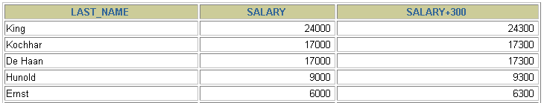

USING ARITHMETIC OPERATORS
SELECT last_name, salary, FROM employees;
salary + 300
…

Slide 12









*
OPERATOR PRECEDENCE
_
/
+
Multiplication and division take priority over addition and subtraction.
Operators of the same priority are evaluated from left to right.
Parentheses are used to force prioritized evaluation and to clarify statements.

Slide 13
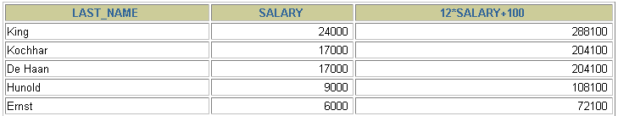
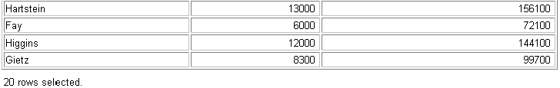
SELECT last_name, salary, FROM employees;
OPERATOR PRECEDENCE
12*salary+100
…

Slide 14
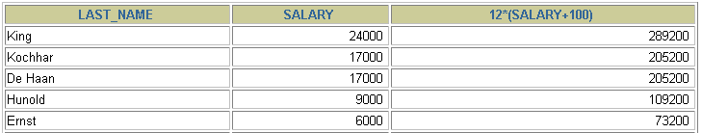

SELECT last_name, salary, FROM employees;
USING PARENTHESES
12*(salary+100)
…

Slide 15
DEFINING A NULL VALUE
A null is a value that is unavailable, unassigned, unknown, or inapplicable.
A null is not the same as zero or a blank space.
SELECT last_name, job_id, salary, FROM employees;
commission_pct
…
…

Slide 16
evaluate to null.
NULL VALUES IN ARITHMETIC EXPRESSIONS
Arithmetic expressions containing a null value
SELECT last_name, 12*salary*commission_pct
FROM employees;
…
…

Slide 17
DEFINING A COLUMN ALIAS
A column alias:
Renames a column heading
Is useful with calculations
Immediately follows the column name - there can also be the optional AS
keyword between the column name and alias
Requires double quotation marks if it contains spaces or special
characters or is case sensitive

Slide 18


USING COLUMN ALIASES
SELECT last_name AS name, commission_pct comm FROM employees;
…
SELECT last_name "Name", salary*12 FROM employees;
"Annual Salary"
…

Slide 19
CONCATENATION OPERATOR
A concatenation operator:
Concatenates columns or character strings to other columns
Is represented by two vertical bars (||)
Creates a resultant column that is a character expression

Slide 20
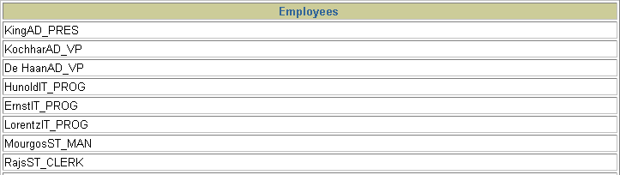
USING THE CONCATENATION OPERATOR
SELECT FROM
last_name||job_id AS "Employees"
employees;
…

Slide 21
LITERAL CHARACTER STRINGS
A literal is a character, a number, or a date included in the SELECT list.
Date and character literal values must be enclosed within single quotation
marks.
Each character string is output once for each row returned.

Slide 22
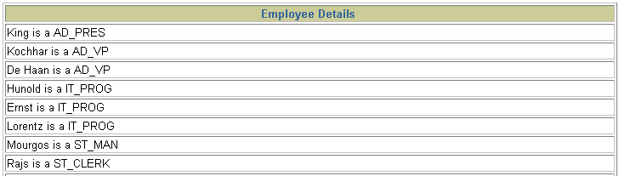
USING LITERAL CHARACTER STRINGS
SELECT last_name ||' is a '||job_id
AS "Employee Details" employees;
FROM
…

Slide 23
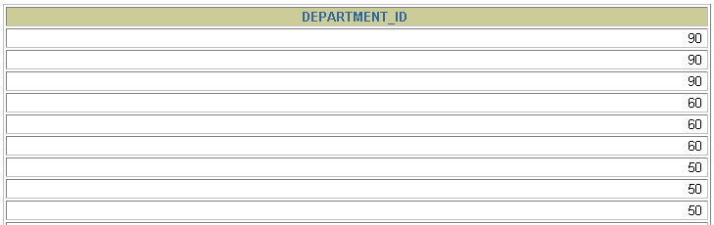
The default display of queries is all rows, including duplicate rows.
DUPLICATE ROWS
SELECT department_id FROM employees;
…

Slide 24
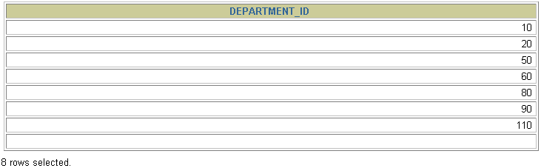
ELIMINATING DUPLICATE ROWS
Eliminate duplicate rows by using the DISTINCT
keyword in the SELECT clause.
SELECT department_id
FROM
DISTINCT
employees;

Slide 25








SQL AND ISQL*PLUS INTERACTION
SQL statements
iSQL*Plus
Oracle
Internet Browser
server
iSQL*Plus commands
Query results
Formatted report
Client

Slide 26










SQL STATEMENTS versus iSQL*PLUS COMMANDS
iSQL*Plus
An environment
Oracle proprietary
Keywords can be abbreviated
Commands do not allow manipulation of values in the database
Runs on a browser
Centrally loaded, does not have to be implemented on each machine
SQL
A language
ANSI standard
Keyword cannot be abbreviated
Statements manipulate data and table definitions in the database
SQL
statements
iSQL*Plus commands

Slide 27
OVERVIEW OF iSQL*PLUS
After you log into iSQL*Plus, you can:
Describe the table structure
Edit your SQL statement
Execute SQL from iSQL*Plus
Save SQL statements to files and append SQL statements to files
Execute statements stored in saved files
Load commands from a text file into the iSQL*Plus Edit window

Slide 28
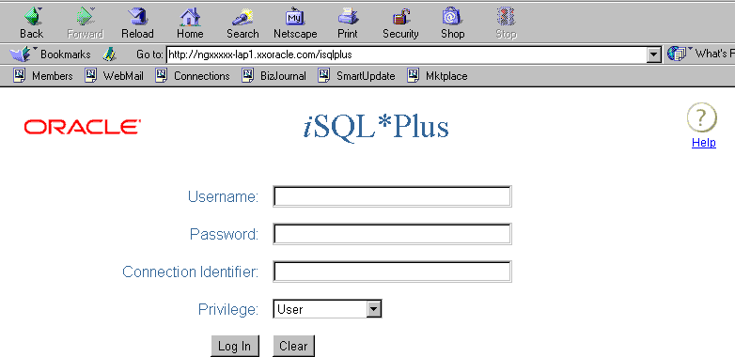
LOGGING IN TO ISQL*PLUS
From your Windows browser environment:

Slide 29
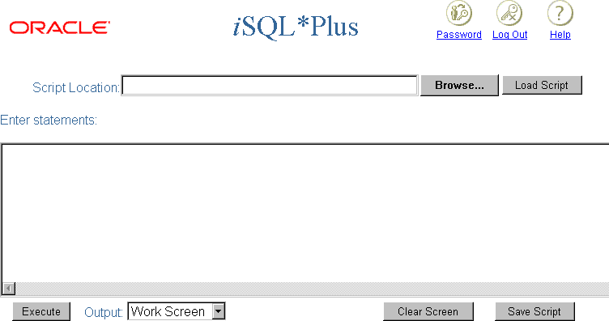
THE iSQL*PLUS ENVIRONMENT
10 8
9
6
1
2
3
4
5

Slide 30
Use the iSQL*Plus DESCRIBE command to display the structure of a table.
DISPLAYING TABLE STRUCTURE
DESC[RIBE] tablename

Slide 31
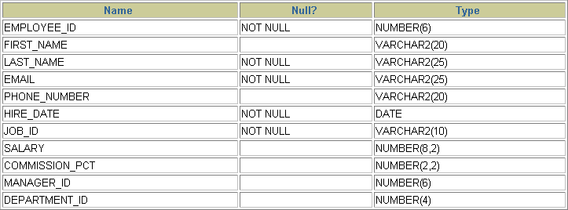
DISPLAYING TABLE STRUCTURE
DESCRIBE employees

Slide 32
INTERACTING WITH SCRIPT FILES
1
2

Slide 33
INTERACTING WITH SCRIPT FILES
1
D:\temp\emp_sql.htm
3

Slide 34
INTERACTING WITH SCRIPT FILES
DESCRIBE employees
SELECT first_name, last_name, job_id FROM employees;
3 2
1

Slide 35
In this lesson, you should have learned how to:
SUMMARY
Write a SELECT statement that:
  Returns all rows and columns from a table
  Returns specified columns from a table
  Uses column aliases to give descriptive column
headings
Use the iSQL*Plus environment to write, save, and execute SQL statements and iSQL*Plus commands.
SELECT FROM
*|{[DISTINCT] column|expression [alias],...}
table;

Slide 36
PRACTICE 1 OVERVIEW
This practice covers the following topics:
Selecting all data from different tables
Describing the structure of tables
Performing arithmetic calculations and specifying column names
Using iSQL*Plus

